Slide 1

Tutorial 8
﻿CS5486 Intelligent Systems:
Mid-term Review
Hongzong Li
Department of Computer Science City University of Hong Kong

Slide 2
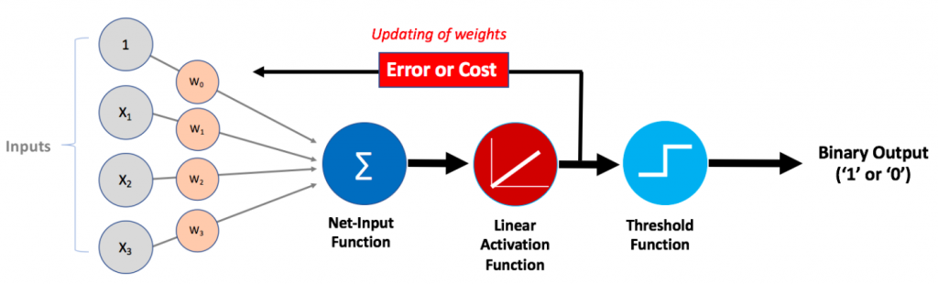
Adaline (Adaptive Linear Neuron)
ADALINE is a type of neural network that is based on the linear activation function. It is very similar to the perceptron but differs in its learning rule. The output of the ADALINE neuron is a linear combination of inputs, and the error is calculated using the difference between the desired output and the actual output.
Continuous-valued Output

Slide 3
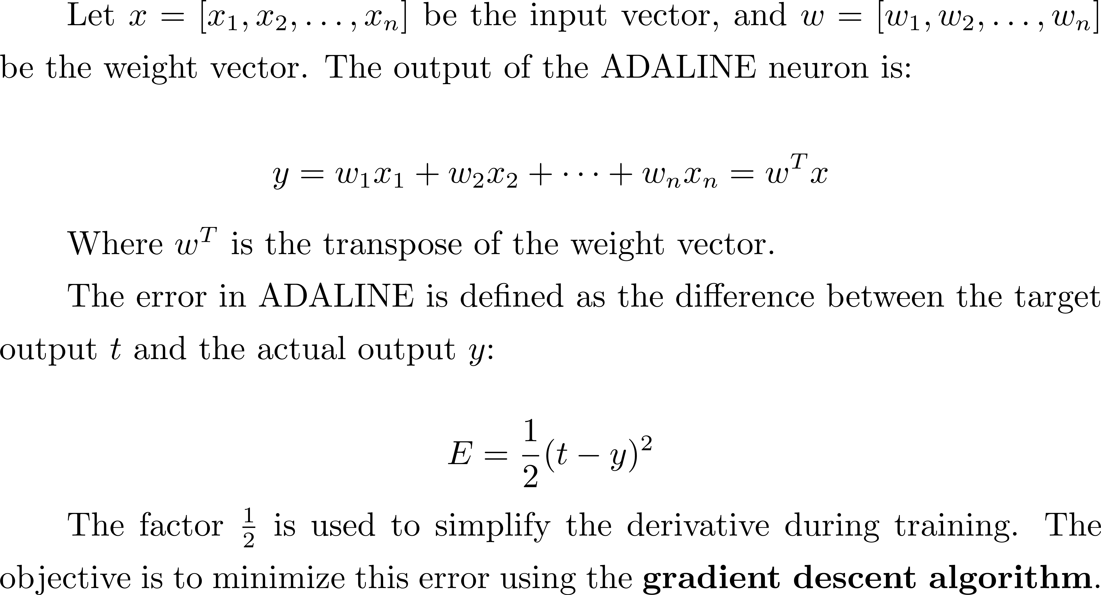
Adaline (Adaptive Linear Neuron)

Slide 4
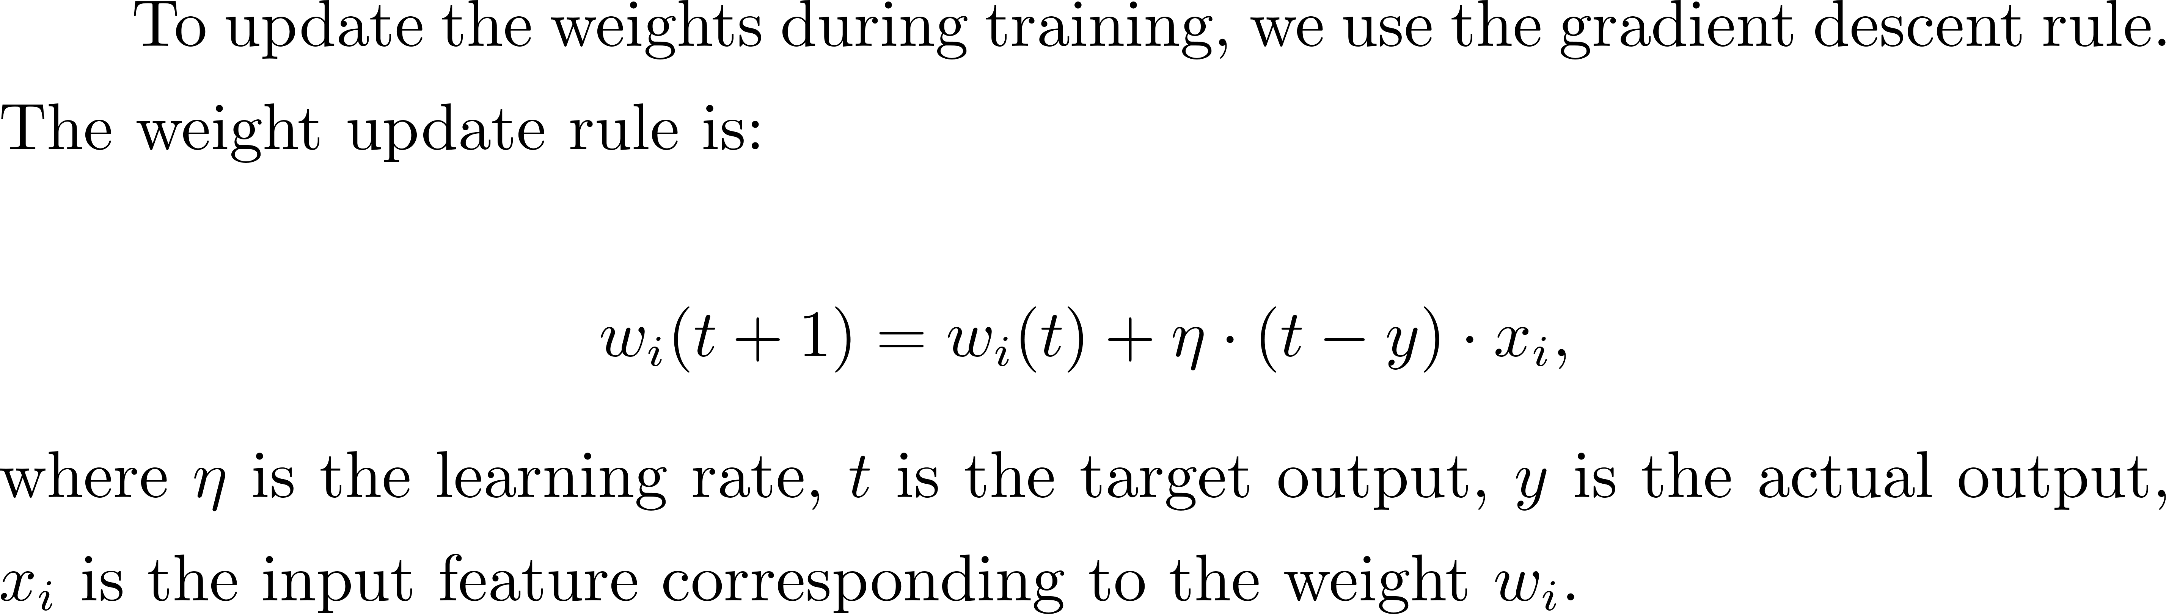
Adaline (Adaptive Linear Neuron)
Learning Rule
Steps for Training ADALINE
Repeat
Initialize weights randomly
Calculate the output
Calculate the output
Compute the error
Convergence

Slide 5
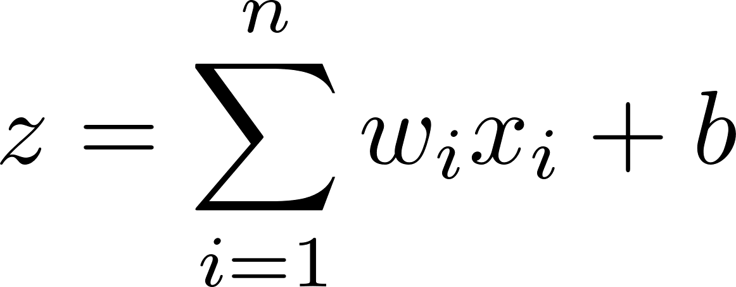
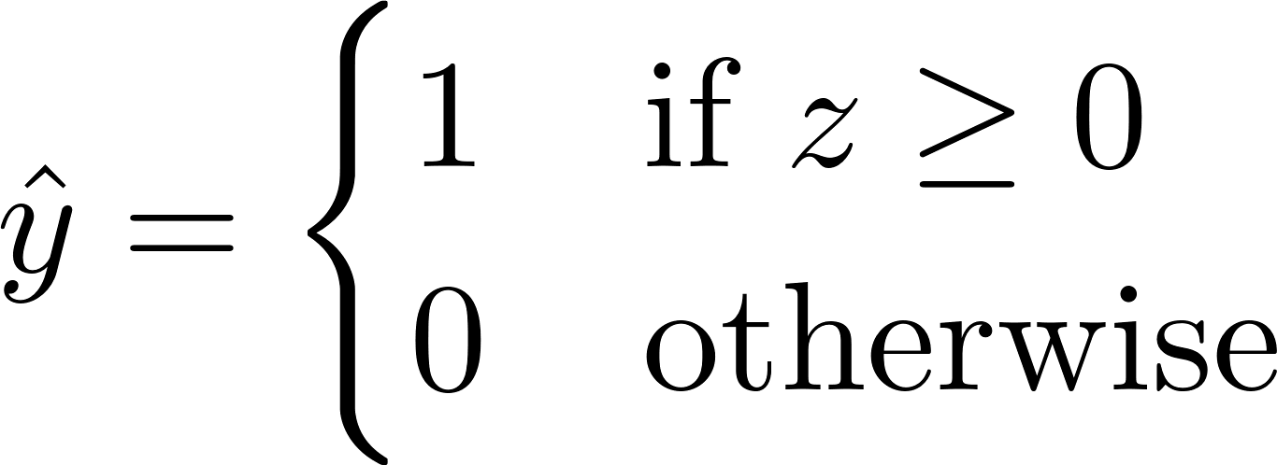
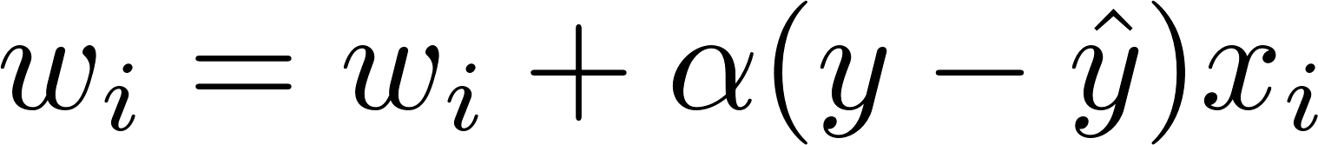
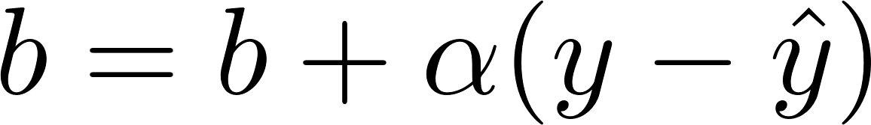

Perceptron
The perceptron is one of the simplest types of artificial neural networks. The perceptron is a linear classifier, meaning it works well when data is linearly separable.
Learning Rule (Weight Update)
is the actual label.

Slide 6
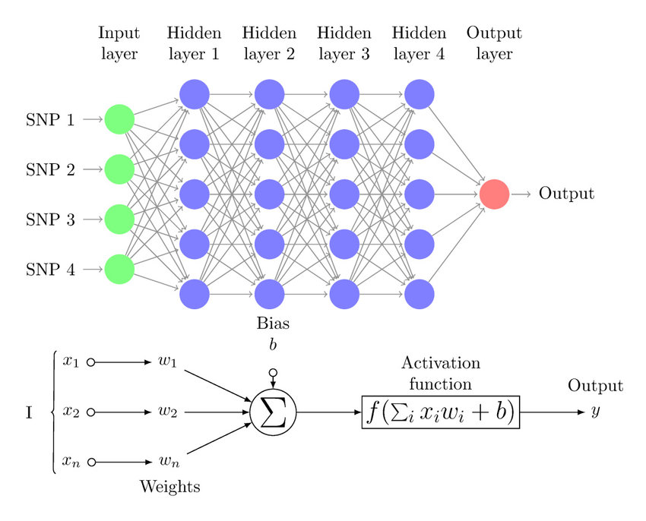
Multilayer Perceptrons
A multilayer perceptron is a type of feedforward neural network consisting of fully connected neurons with a nonlinear kind of activation function.

Slide 7
Multilayer Perceptrons
Input layer
The input layer consists of nodes or neurons that receive the initial input data. The number of neurons in the input layer is determined by the dimensionality of the input data.

Slide 8
Multilayer Perceptrons
Hidden layer
Between the input and output layers, there can be one or more layers of neurons. The number of hidden layers and the number of neurons in each hidden layer are hyperparameters that need to be determined during the model design phase.

Slide 9
Multilayer Perceptrons
Output layer
This layer consists of neurons that produce the final output of the network. The number of neurons in the output layer depends on the nature of the task.

Slide 10
Multilayer Perceptrons
Weights
Neurons in adjacent layers are fully connected to each other. Each connection has an associated weight, which determines the strength of the connection. These weights are learned during the training process.
Bias neurons
In addition to the input and hidden neurons, each layer (except the input layer) usually includes a bias neuron that provides a constant input to the neurons in the next layer. Bias neurons have their own weight associated with each connection, which is also learned during training.

Slide 11
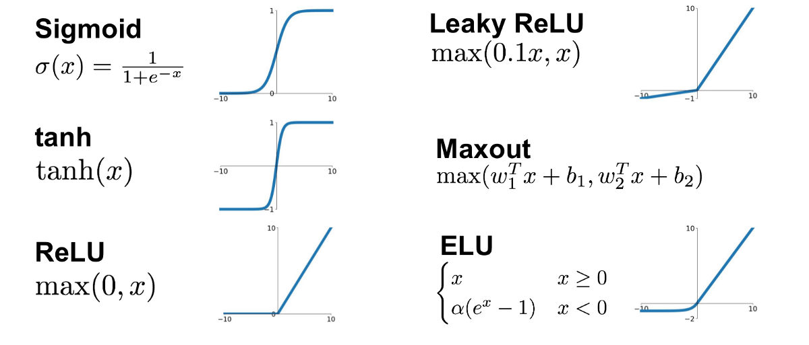
Multilayer Perceptrons
Activation function
Typically, each neuron in the hidden layers and the output layer applies an activation function to its weighted sum of inputs. Common activation functions include sigmoid, tanh, ReLU (Rectified Linear Unit), and soft-max. These functions introduce nonlinearity into the network, allowing it to learn complex patterns in the data.

Slide 12
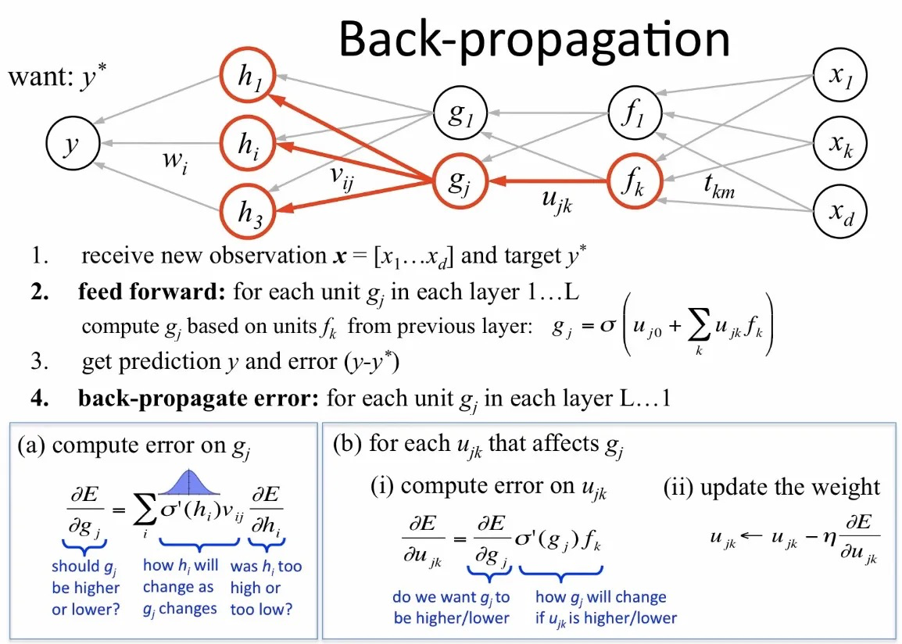
Multilayer Perceptrons
Training with backpropagation
Notes:
Calculate the gradient (how much change is needed) of the error with respect to each weight.
Update the weights in the opposite direction of the gradient to reduce the error.

Slide 13
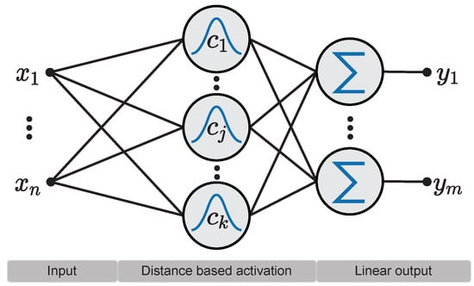
Radial Basis Function (RBF) Neural Networks
Radial Basis Function (RBF) Neural Networks are a specialized type of Artificial Neural Network (ANN) used primarily for function approximation tasks.
Three-layer architecture
Notes:
RBF network in its simplest form is a three-layer feedforward neural network. The first layer corresponds to the inputs of the network, the second is a hidden layer consisting of a number of RBF non-linear activation units, and the last one corresponds to the final output of the network.
Activation functions in RBFNs are conventionally implemented as Gaussian functions. Here shows an example of the RBFN structure.

Slide 14
Radial Basis Function (RBF) Neural Networks
RBF and MLP belong to a class of neural networks called feed-forward networks.
What is the difference between RBF and MLP?
In RBF, each hidden unit act as a point in input space and activation/output for any instance depends on the distance between that point(Hidden Unit) and instance(a sample point)
RBF learns two kinds of parameters: 1) Centers and width of RBFs. 2) Weights to from linear combination of outputs obtained from hidden layer.
Notes:
RBF and MLP belong to a class of neural networks called feed-forward networks.
Hidden layer of RBF is different from MLP. It performs some computations. Each hidden unit act as a point in input space and activation/output for any instance depends on the distance between that point(Hidden Unit) and instance(Also a point in space).
Thus, RBF learns two kinds of parameters: 1) Centers and width of RBFs 2) Weights to from linear combination of outputs obtained from hidden layer

Slide 15


Radial Basis Function (RBF) Neural Networks
The output of the i-th activation function in the hidden layer of the network can be calculated based on the distance between the input pattern x and the center c_{i} as follows:

Slide 16

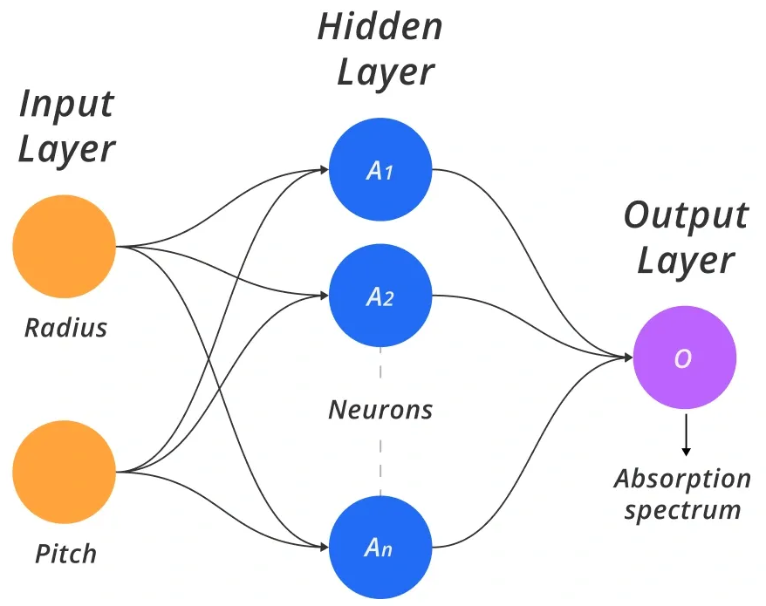
Radial Basis Function (RBF) Neural Networks
Then, the output of the node k of the output layer of the network can be calculated as follows:

Slide 17
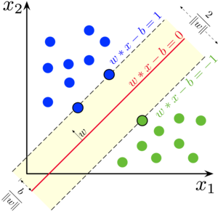
Support Vector Machine
Support Vector Machines (SVM) are powerful supervised learning algorithms widely used for classification and regression tasks.
SVM is a discriminative classifier that finds an optimal decision boundary (hyperplane) to separate different classes in a dataset. It works by maximizing the margin between data points of different classes.

Slide 18
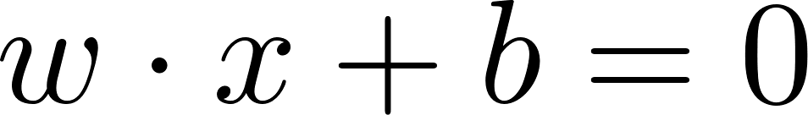
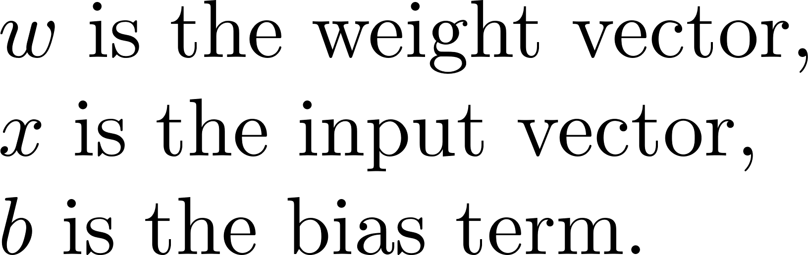
Support Vector Machine
Given a dataset with two classes, SVM finds a hyperplane that maximizes the margin.

Slide 19
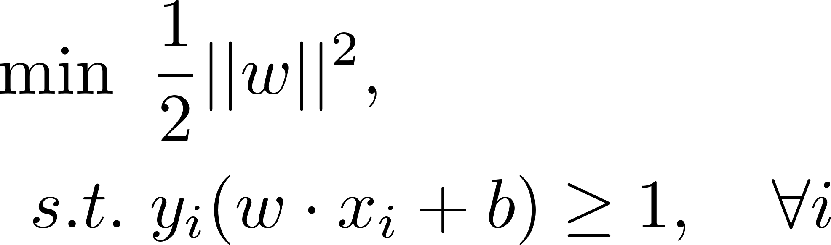
Support Vector Machine
Maximize the Margin
maximizes the margin
classification error

Slide 20
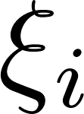
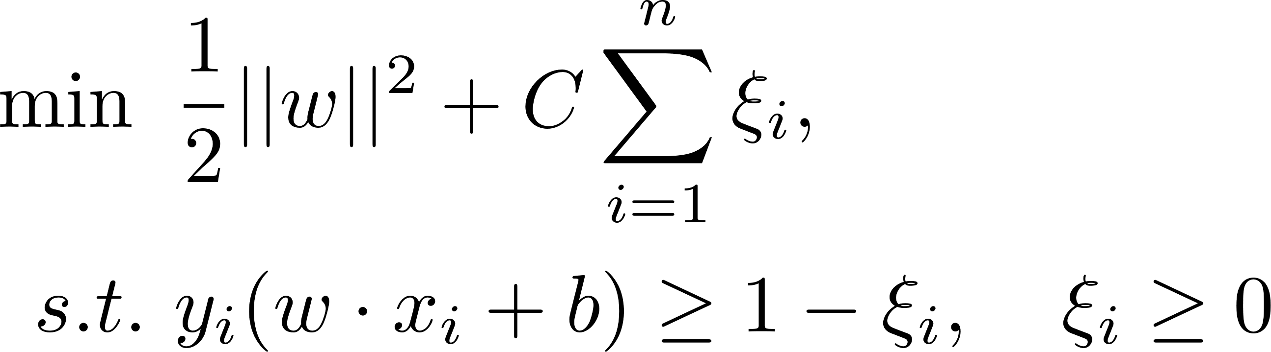
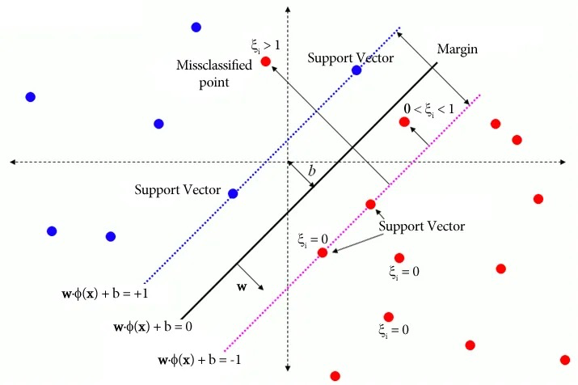
Support Vector Machine
Soft-Margin SVM (For Non-Separable Data)
introduce slack variables to allow some misclassifications:

Slide 21
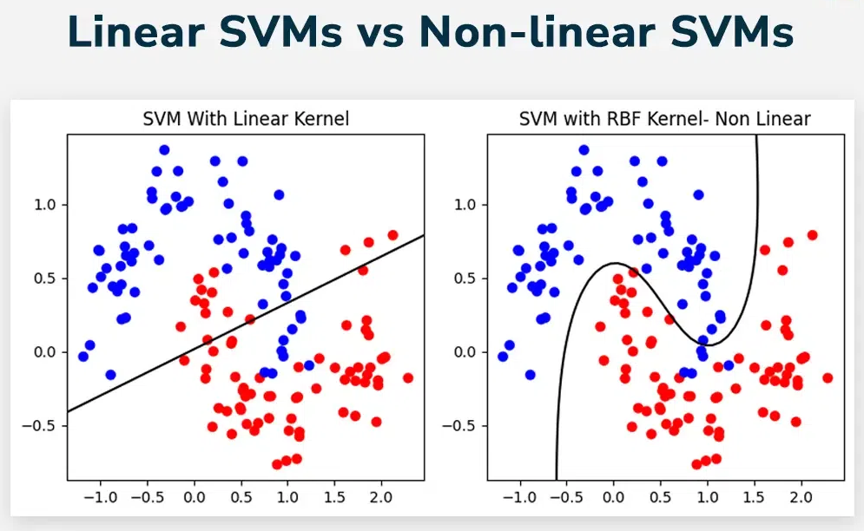
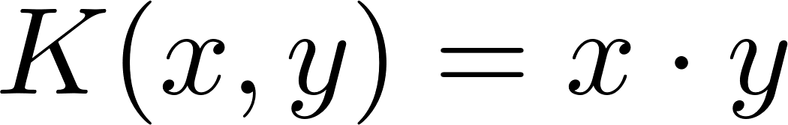
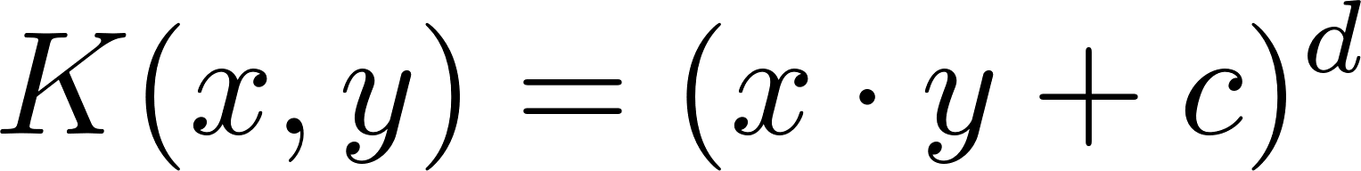
Support Vector Machine
When data is not linearly separable
Common Kernels:
Linear Kernel:
Polynomial Kernel:
Radial Basis Function (RBF) Kernel:
Sigmoid Kernel:
Notes:
If data is not linearly separable, SVM maps data into a higher-dimensional space using a kernel function \( K(x_i, x_j) \), which replaces the dot product:

Slide 22
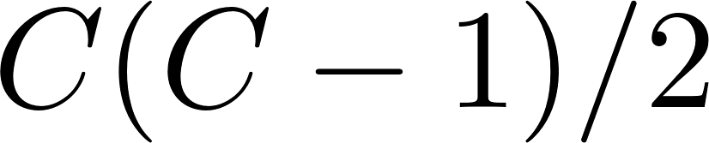
Support Vector Machine
Multi-Class Classification
1. One-vs-One (OvO)
Trains classifiers for C classes.
Each classifier is trained on a pair of classes.
The final prediction is determined using a voting mechanism.
2 One-vs-All (OvA)
Trains C classifiers for C classes.
Each classifier separates one class from all others.
The final prediction is made based on the highest decision score.

Slide 23
Thanks

